Slide 1
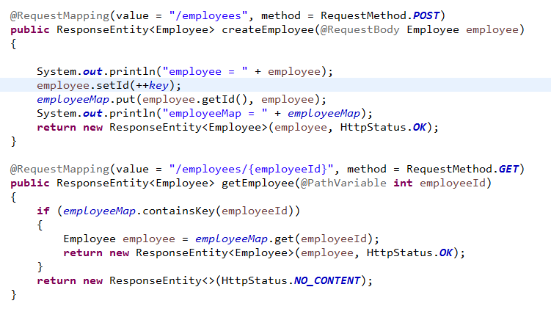
Handle HTTP POST, PUT, Get and Delete Requests - Store Employees Temporary

Slide 2
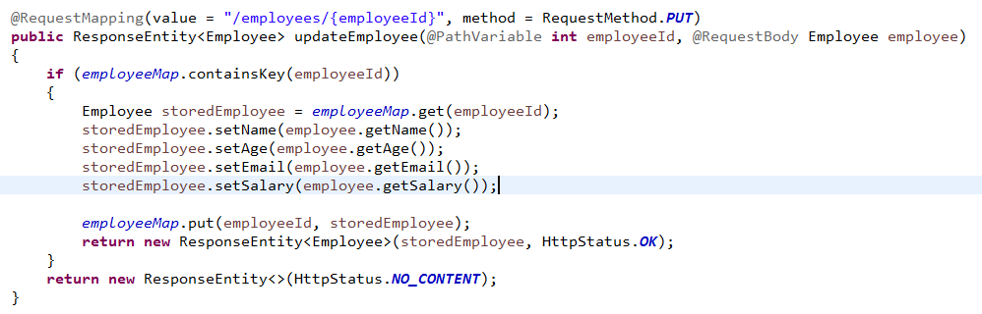
Handle HTTP POST, PUT, Get and Delete Requests - Store Employees Temporary

Slide 3
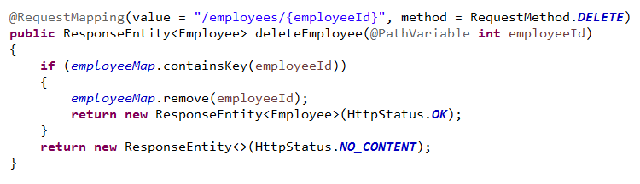
Handle HTTP POST, PUT, Get and Delete Requests - Store Employees Temporary

